Slide 1
Software Design with Design Principle and Design Pattern
Trainer: Sourav Maitra

Slide 2
Road Map
Software Design Principle
Software Design Patterns
SOLID
Design Patterns Introduction Need and Benefits of Design Patterns
Design Patterns - Creational: Singleton, Factory, Abstract Factory
Design Patterns - Structural: Adapter, Decorator, Bridge, Façade
Design Patterns - Behavioral: Chain of Responsibility, Mediator, Observer

Slide 3
Software Design Principle
Principles are abstract guidelines or rules that help developers write better code
They provide a framework for making design decisions but don't prescribe specific implementations.
Examples
SOLID(Single Responsibility, Open-Closed, Liskov Substitution, Interface Segregation, Dependency Inversion)
DRY(Do not Repeat Yourself)
KISS (Keep It Short and Simple)

Slide 4
Software Design Patterns
Design patterns are reusable solutions to common software design problems
They provide proven blueprints for creating flexible, maintainable, and efficient code.
Design patterns are often based on specific principles, but they offer concrete implementations and examples of how to apply those principles in practice.
Example:
Factory,
Singleton,
Observer, and Strategy.

Slide 5
To Summarize….
Principles are abstract guidelines that provide a framework for design decisions.
Design patterns are concrete solutions to common design problems.

Slide 6
Why to learn?
By understanding both principles and design patterns, developers can create better, more maintainable, and scalable software.

Slide 7
SOLID

Slide 8
SOLID Principle
Acronym for
S ➔ Single Responsibility Principle
O ➔ Open/Closed Principle
L ➔ Liscov Substitution Principle
I ➔ Interface Segregation Principle
D ➔ Dependency Inversion Principle

Slide 9
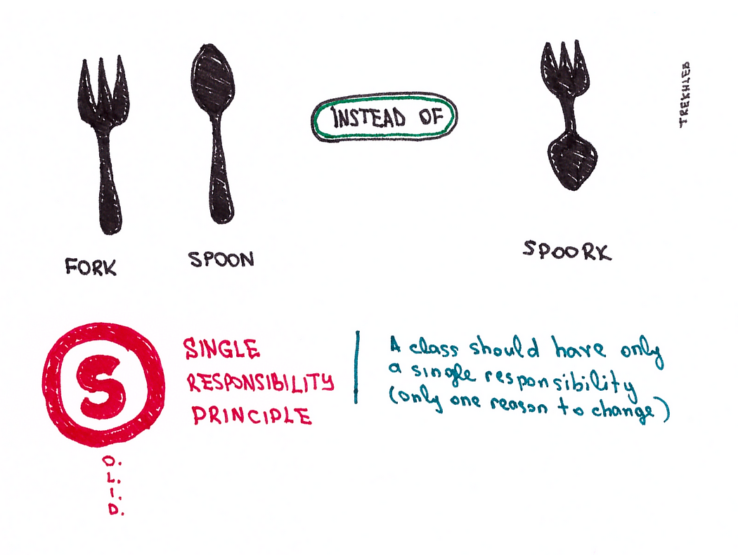
S➔ Single Responsibility Principle
A class should have only one reason to change.
Focus on a single, well-defined responsibility.

Slide 10
Scenario
S
R
P
Refer to the Program Block
Try Understanding Bad Design First and then Good Design

Slide 11
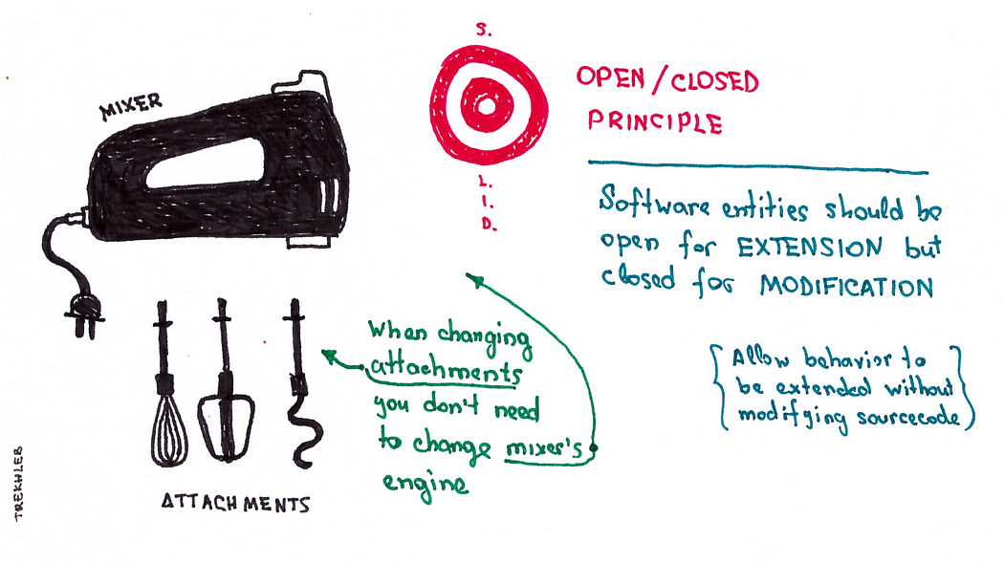
O ➔ Open/Closed Principle
Classes should be open for extension but closed for modification.
Add new functionality without changing existing code.

Slide 12
Scenario
OCP
Refer to the Program Block
Try Understanding Bad Design First and then Good Design

Slide 13
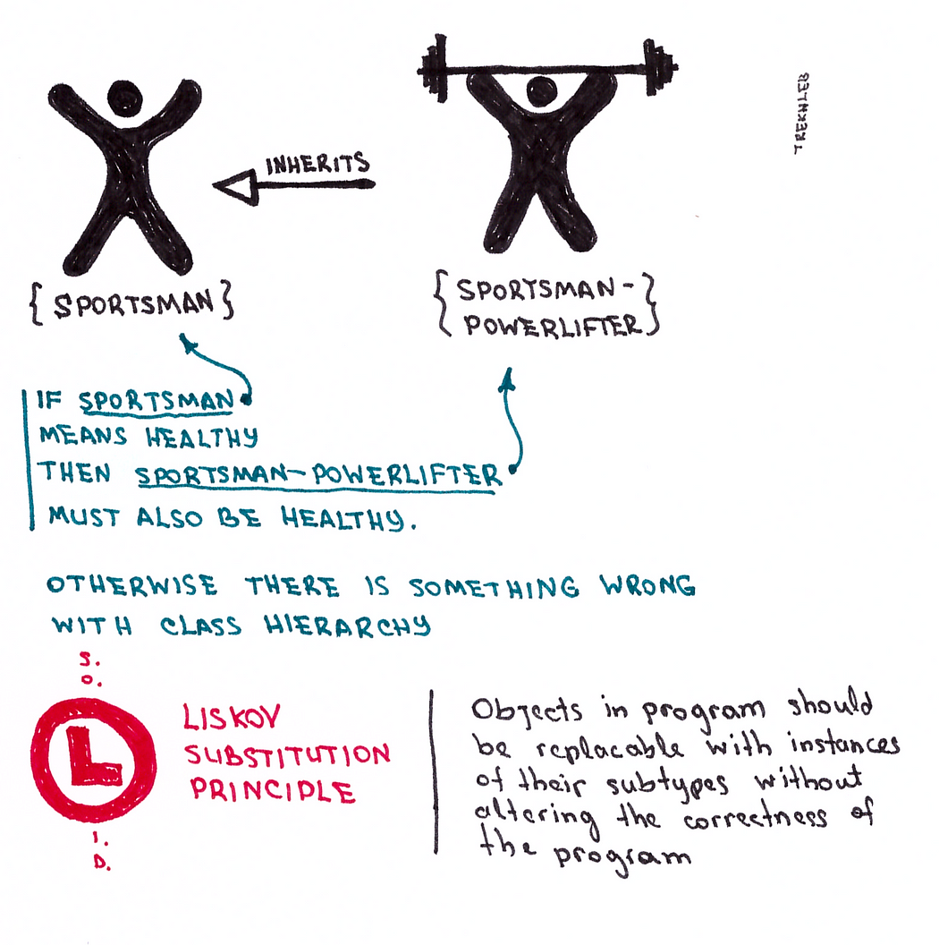
L ➔ Liscov Substitution Principle
Objects of a derived class must be substitutable for objects of the base class without affecting the correctness of the program.
Ensure derived classes adhere to the contract defined by the base class

Slide 14
Scenario
LSP
Refer to the Program Block
Try Understanding Bad Design First and then Good Design

Slide 15
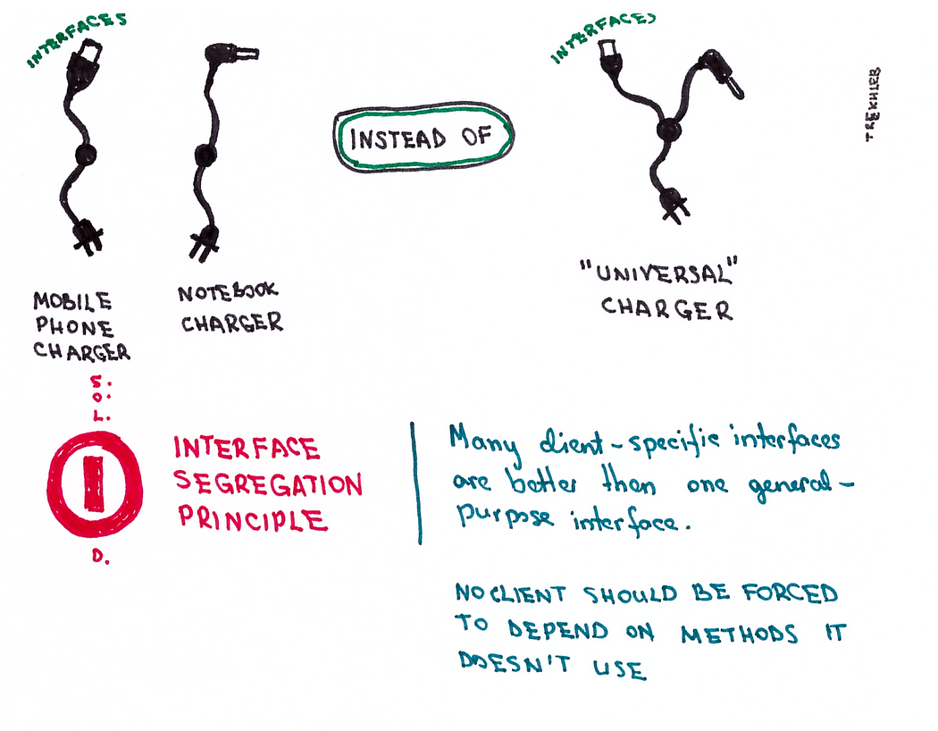
I ➔ Interface Segregation Principle
Clients should not be forced to depend on interfaces they do not use.
Break down large interfaces into smaller, more specific ones

Slide 16
Scenario
I SP
Refer to the Program Block
Try Understanding Bad Design First and then Good Design

Slide 17
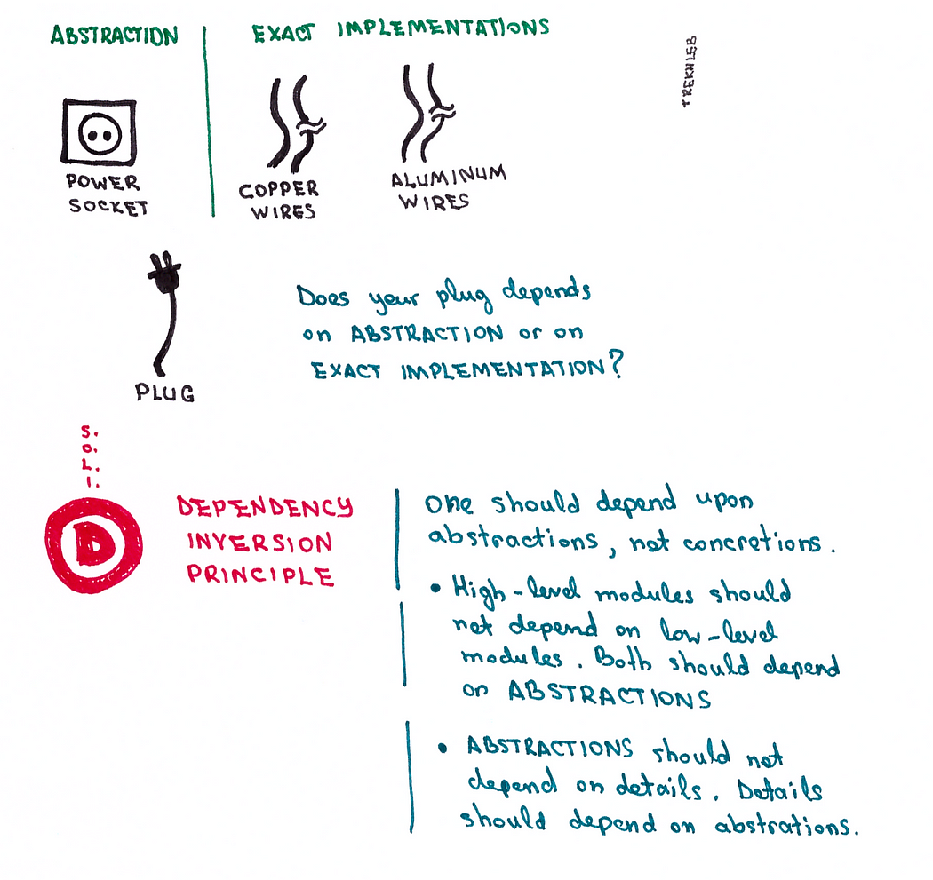
I ➔ Dependency Inversion Principle
Depend on abstractions, not concretions
High-level modules should not depend on low-level modules. Both should depend on abstractions
.

Slide 18
Scenario
DIP
Refer to the Program Block
Try Understanding Bad Design First and then Good Design

Slide 19
Thanks

Slide 20
Design Pattern
Design patterns are reusable solutions to common software design problems.
They provide proven blueprints for creating flexible, maintainable, and efficient code.
These patterns are not tied to a specific programming language but are applicable across different programming paradigms.

Slide 21
Why Use Design Patterns?
Improved Code Quality: Design patterns promote code that is more readable, maintainable, and extensible. They help prevent common anti-patterns and ensure code adheres to best practices.
Enhanced Collaboration: Patterns provide a common vocabulary and understanding among developers, facilitating collaboration and knowledge sharing.
Faster Development: By leveraging established solutions, developers can avoid reinventing the wheel and focus on implementing core business logic.
Reduced Bugs: Patterns often address common pitfalls and design flaws, leading to fewer bugs and improved software reliability.
Adaptability: Design patterns make code more adaptable to change, allowing for easier modifications and extensions in the future

Slide 22
Benefits of Using Design Patterns
Reusability: Patterns can be reused across different projects, saving time and effort.
Readability: Well-applied patterns make code easier to understand and maintain.
Extensibility: Patterns can be adapted to accommodate new requirements without significant changes.
Flexibility: Patterns provide a framework for building flexible and adaptable systems
Maintainability: Code that follows design patterns is generally easier to maintain and modify

Slide 23
Categories of Design Patterns
Design Pattern
Creational
Structural
Behavioural

Slide 24
Creational Patterns
These patterns deal with object creation. They provide ways to create objects in a flexible and controlled manner
These patterns provide various object creation mechanisms, which increase flexibility and reuse of existing code.
Examples
Factory Method: Defines an interface for creating an object, but let subclasses decide which class to instantiate
Abstract Factory: Provides an interface for creating families of related or dependent objects without specifying their concrete classes
Singleton: Ensures a class has only one instance and provides a global point of access to it
Builder: Separates the construction of a complex object from its representation, allowing the same construction process to create different representations.
Prototype: Creates new objects by copying an existing object

Slide 25
Structural Patterns
These patterns deal with how objects are composed and related to each other. They focus on the relationships between objects
Examples
Adapter: Converts the interface of a class into another interface clients expect
Bridge: Decouples an abstraction from its implementation, so the two can vary independently
Composite: Composes objects into tree structures to represent part-whole hierarchies
Decorator: Attaches additional responsibilities to an object dynamically
Facade: Provides a unified interface to a set of interfaces in a subsystem
Flyweight: Reduces memory usage by sharing common objects
Proxy: Provides a surrogate or placeholder for another object to control access to it

Slide 26
Behavioural Patterns
These patterns deal with how objects interact and communicate with each other. They focus on the algorithms and responsibilities of objects Examples
Template Method: Defines the skeleton of an algorithm in an operation, deferring some steps to subclasses
Strategy: Defines a family of algorithms, encapsulates each one, and makes them interchangeable
Observer: Defines a one-to-many dependency between objects so that when one object changes state, all its dependents are notified and updated automatically
Iterator: Provides a way to access the elements of an aggregate object sequentially without exposing its internal representation
Visitor: Represents an operation to be performed on the elements of an object structure
Mediator: Defines an object that encapsulates how a set of objects interact
Memento: Captures the internal state of an object so that it can be restored to this state later
State: Allows an object to alter its behavior when its internal state changes
Command: Encapsulates a request as an object, thereby letting you parameterize clients with different requests, queue or log requests, and support undoable operations

Slide 27
Creational Patterns
Pattern Name | Purpose | Example
Abstract Factory | Creates an instance of several families of classes | A factory for creating different types of cars (e.g., sports cars, sedans, SUVs)
Builder | Separates object construction from its representation | A builder for creating complex objects like houses
Factory Method | Creates an instance of several derived classes | A factory for creating different types of documents (e.g., Word, PDF)
Prototype | A fully initialized instance to be copied or cloned | Cloning a user object to create a new user
Singleton | A class of which only a single instance can exist | A database connection pool

Slide 28
Structural Patterns
Pattern Name | Purpose | Example
Adapter | Match interfaces of different classes | Adapting a legacy database to work with a modern framework
Bridge | Separates an object’s interface from its implementation | A bridge between a drawing API and different drawing platforms
Composite | A tree structure of simple and composite objects | A file system hierarchy
Decorator | Add responsibilities to objects dynamically | Adding features to a basic car (e.g., sunroof, GPS)
Facade | A single class that represents an entire subsystem | A facade for a complex subsystem like a network library
Flyweight | A fine-grained instance used for efficient sharing | Sharing character objects in a word processor
Proxy | An object representing another object | A proxy for a remote object

Slide 29
Behavioural Patterns
Pattern Name | Purpose | Example
Chain of Responsibility | A way of passing a request between a chain of objects | A chain of approval for a purchase request
Command | Encapsulate a command request as an object | Undo/redo functionality in a text editor
Interpreter | A way to include language elements in a program | A parser for a simple programming language
Iterator | Sequentially access the elements of a collection | Iterating over elements in a list
Mediator | Defines simplified communication between classes | A mediator for communication between different UI components
Memento | Capture and restore an object's internal state | Saving a game state in a video game
Observer | A way of notifying change to a number of classes | A subject notifying observers when its state changes
State | Alter an object's behavior when its state changes | A traffic light changing its state (red, yellow, green)
Strategy | Encapsulates an algorithm inside a class | Different sorting algorithms for a list
Template Method | Defer the exact steps of an algorithm to a subclass | A template for a report generation process
Visitor | Defines a new operation to a class without change | A visitor to calculate the total area of different shapes

Slide 30
Creational: Singleton
Singleton Pattern
Purpose: The Singleton Pattern ensures that a class has only one instance and provides a global point of access to that instance. This pattern is used when exactly one instance of a class is needed to coordinate actions across the system.
Analogy: Think of a president of a country. There can only be one president at a time, and everyone in the country needs to access that single president for decisions and coordination. The president's role and access are unique, just as the Singleton pattern ensures that there is only one instance of a class.

Slide 31
Creational: Factory
Factory Method Pattern
Purpose: The Factory Method Pattern defines an interface for creating objects but allows subclasses to alter the type of objects that will be created. This pattern is used to delegate the instantiation logic to child classes, allowing the code to be more flexible and reusable.
Analogy: Imagine a bakery that offers a variety of baked goods. Instead of a single person (or method) baking all kinds of pastries, there are different bakers specialized in creating different items (e.g., cakes, breads, pastries). Each baker (factory) creates a specific type of product, and the bakery (client) can get different types of baked goods without knowing the details of how each type is made.

Slide 32
Creational: Abstract Factory
Abstract Factory Pattern
Purpose: The Abstract Factory Pattern provides an interface for creating families of related or dependent objects without specifying their concrete classes. It is used when a system needs to create multiple products that belong to a family of related products, ensuring that the products are compatible with each other.
Analogy: Consider a furniture store that sells different styles of furniture, such as modern or classic. Instead of having a single factory that produces all types of furniture, you have different factories for each style (e.g., ModernFurnitureFactory, ClassicFurnitureFactory). Each factory produces a set of related products (e.g., chairs, tables, sofas) that fit within that style. The store can offer a complete set of matching furniture without worrying about how each piece is made.

Slide 33
Summary
Singleton Pattern: Ensures a class has only one instance and provides a global point of access.
Analogy: A country’s president, who represents the sole leader with global access.
Factory Method Pattern: Allows subclasses to decide which class to instantiate, providing a way to delegate the instantiation logic.
Analogy: Different bakers in a bakery, each specializing in a type of baked good.
Abstract Factory Pattern: Creates families of related objects without specifying their concrete classes, ensuring compatibility among the products.
Analogy: Furniture store with multiple factories producing related furniture styles.

Slide 34
Structural
Adapter Pattern
Purpose: The Adapter Pattern allows two incompatible interfaces to work together. It acts as a bridge between two incompatible interfaces, enabling objects that couldn’t normally interact due to incompatible interfaces to do so.
Analogy: Think of it like a power adapter that allows you to plug a device from one country (with a different plug shape) into a socket in another country.

Slide 35
Structural
Decorator Pattern
Purpose: The Decorator Pattern allows behavior to be added to individual objects, either statically or dynamically, without affecting the behavior of other objects from the same class. It’s a way to extend functionality by wrapping an object in a decorator class.
Analogy: Imagine adding layers of clothing. Each layer (decorator) adds something new (warmth, style) to the basic outfit (the object) without altering the outfit itself.

Slide 36
Structural
Bridge
Purpose: The Bridge Pattern decouples an abstraction from its implementation, so that the two can vary independently. It separates the interface (abstraction) from the implementation, allowing you to change them independently.
Analogy: Think of it as the relationship between a remote control (abstraction) and a television (implementation). The remote can control different TVs, and the TVs can be changed or updated without needing to change the remote.

Slide 37
Structural
Facade
Purpose: The Facade Pattern provides a simplified interface to a complex subsystem. It hides the complexities of the system and provides a single point of access to the functionality of the subsystem.
Analogy: Consider the front desk of a hotel. The front desk provides a simple way for guests to interact with various hotel services (booking rooms, requesting room service) without needing to deal with each service individually.

Slide 38
Structural: Summary
Adapter: Converts one interface to another to make two incompatible interfaces work together.
Decorator: Adds additional responsibilities to an object dynamically without changing its interface.
Bridge: Decouples abstraction from implementation, allowing both to evolve independently.
Facade: Provides a simplified, unified interface to a complex subsystem.

Slide 39
Behavioural: Chain of Responsibility
Purpose: The Chain of Responsibility pattern allows multiple objects the opportunity to handle a request by passing the request along a chain of potential handlers until one of them handles it. This pattern decouples the sender of a request from its receivers, allowing multiple objects to process the request without knowing which one will eventually handle it.
Analogy: Imagine you're applying for a loan at a bank. The application doesn't directly go to the bank manager. Instead, it first goes to a customer service representative. If the application is straightforward, the representative might approve it on the spot. If it's more complex, the representative passes it to a credit officer. If the credit officer finds issues or it's a large loan, it might go to the branch manager. The request is handled by whoever has the authority and the right context to deal with it, without knowing upfront who that will be.

Slide 40
Behavioural: Mediator
Purpose: The Mediator pattern defines an object that encapsulates how a set of objects interact. This pattern promotes loose coupling by keeping objects from referring to each other explicitly and lets you vary their interaction independently.
Analogy: Think of a busy airport control tower. Pilots do not communicate directly with each other to coordinate take-offs, landings, or taxiing. Instead, they all communicate with the control tower, which manages all the interactions. The control tower (mediator) ensures that planes take off and land safely without needing to communicate directly with each other, thereby simplifying and centralizing communication.

Slide 41
Behavioural: Observer
Purpose: The Observer pattern defines a one-to-many dependency between objects, so that when one object changes state, all its dependents are notified and updated automatically. This pattern is useful when an object needs to notify other objects about changes without being tightly coupled to them.
Analogy: Consider a newsletter subscription. When you subscribe to a newsletter, you become an observer. The newsletter publisher maintains a list of all subscribers (observers). When new content (news) is published, all subscribers are notified via email. The publisher doesn't need to know who the subscribers are or how many there are; it simply sends out the news to all registered observers.

Slide 42
Summary
Chain of Responsibility: Handles requests in a chain until one object handles it.
Analogy: Loan application process in a bank.
Mediator: Centralizes communication between objects to reduce direct dependencies.
Analogy: Air traffic control in an airport.
Observer: Notifies multiple objects of a change in state automatically.
Analogy: Newsletter subscription notification system.

